Slide 1
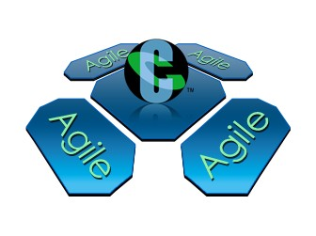
Daikibo™
An Agile framework for large scale distributed development
Daikibo © April 2010
All rights reserved.
Daikibo is a trademark of Cognizant Technology Solutions US Corporation, Inc.

Slide 2
Daikibo - Introduction

Slide 3
Daikibo
大規模
{ Daikibo }
Japanese Phrase For
“Large Scale”
Daikibo perfectly encompasses Cognizant’s
Scalable, Distributed, Hybrid Agile approach
with Location Transparency
Distributed Teams or Integrated Teams
大
規
模

Slide 4
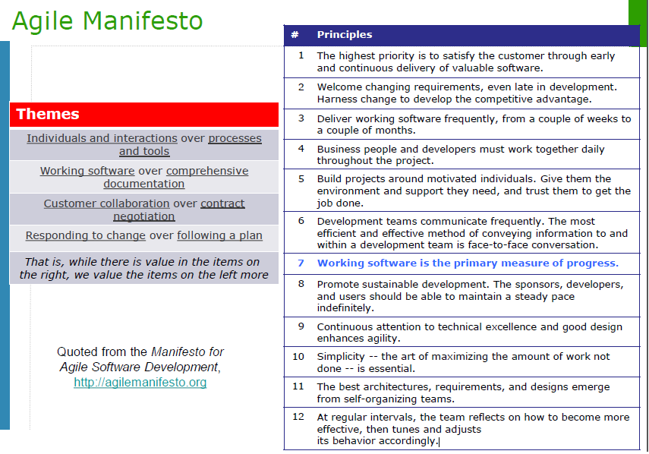

Slide 5
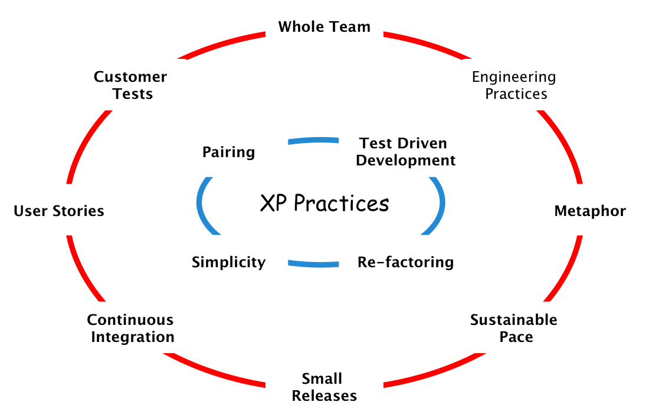
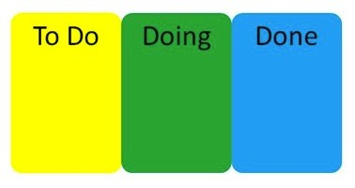
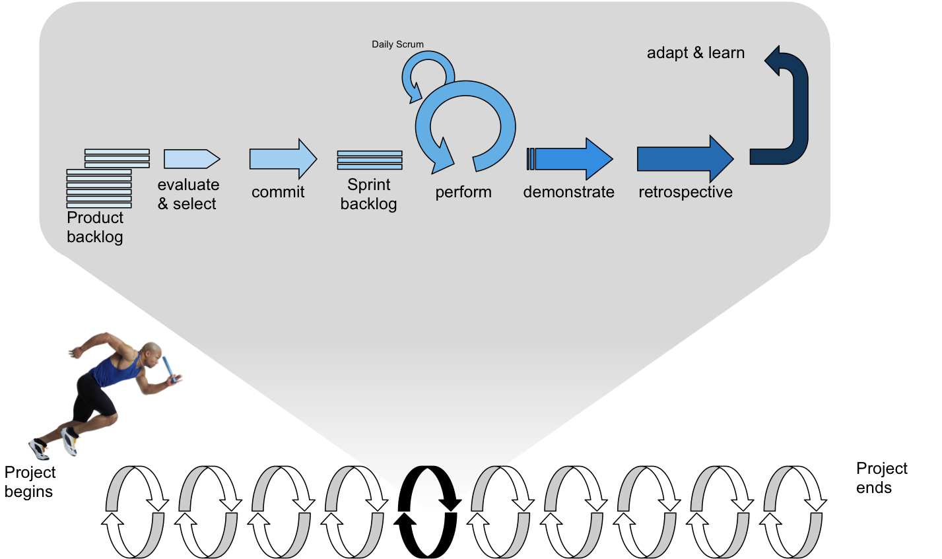
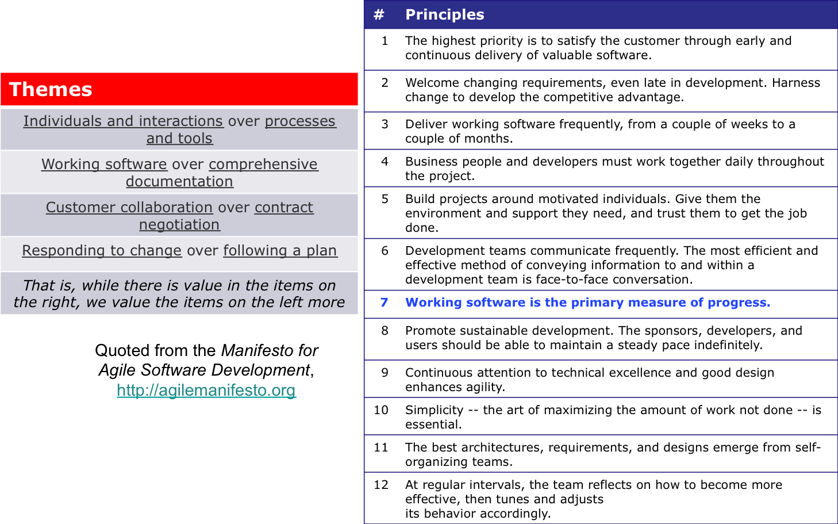
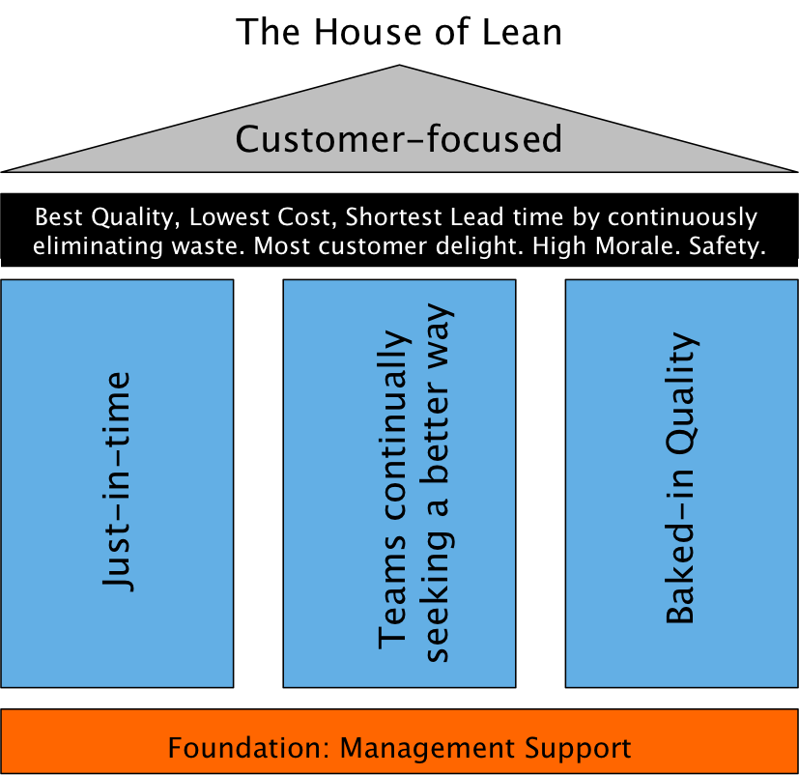
Background on Daikibo
Daikibo is a combination of Scrum, Kanban, and XP frameworks, and supports both Agile and Lean principles.
XP
Kanban
Scrum
大規模
Daikibo
Agile
Lean

Slide 6
Daikibo – The Engine

Slide 7




Daikibo – Delivery Engine
Delivery Team
ATF
PO Proxy
大
規
模
Concept Team
Product owner
Story Authors
Developers
Testers
SMEs & SDAs
Test & Technical Ambassador
Delivery Team
ATF
PO Proxy
Meta Team
Chief Product owner
Developers
Testers
IVT Team
Test & Technical Ambassador
Testers
Performance
SMEs & SDAs
Story Authors
Delivery Team
Automation & Regression
ATF
PO Proxy
Concept Team
Product owner
Story Authors
Developers
Testers
SMEs & SDAs
Test & Technical Ambassador
Delivery Team
ATF
PO Proxy
Developers
Testers
Notes:
“Hybrid” Daikibo™ Agile Approach
Separate cross-functional teams and bifurcated responsibilities (a producer-consumer model) operating in an incremental-iterative pipeline approach, following Agile principles with Scrum.
Concept team – story production/generation
Delivery team – story consumption
Integrated Validation (IVT) team – story validation

Slide 8
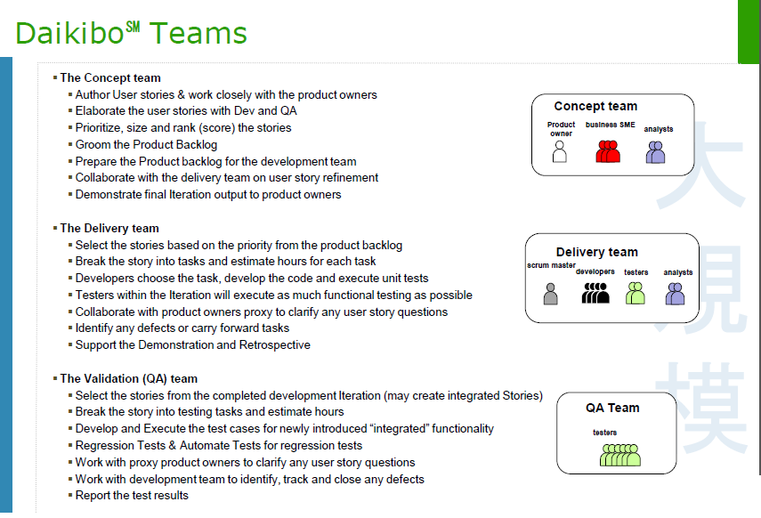

Slide 9
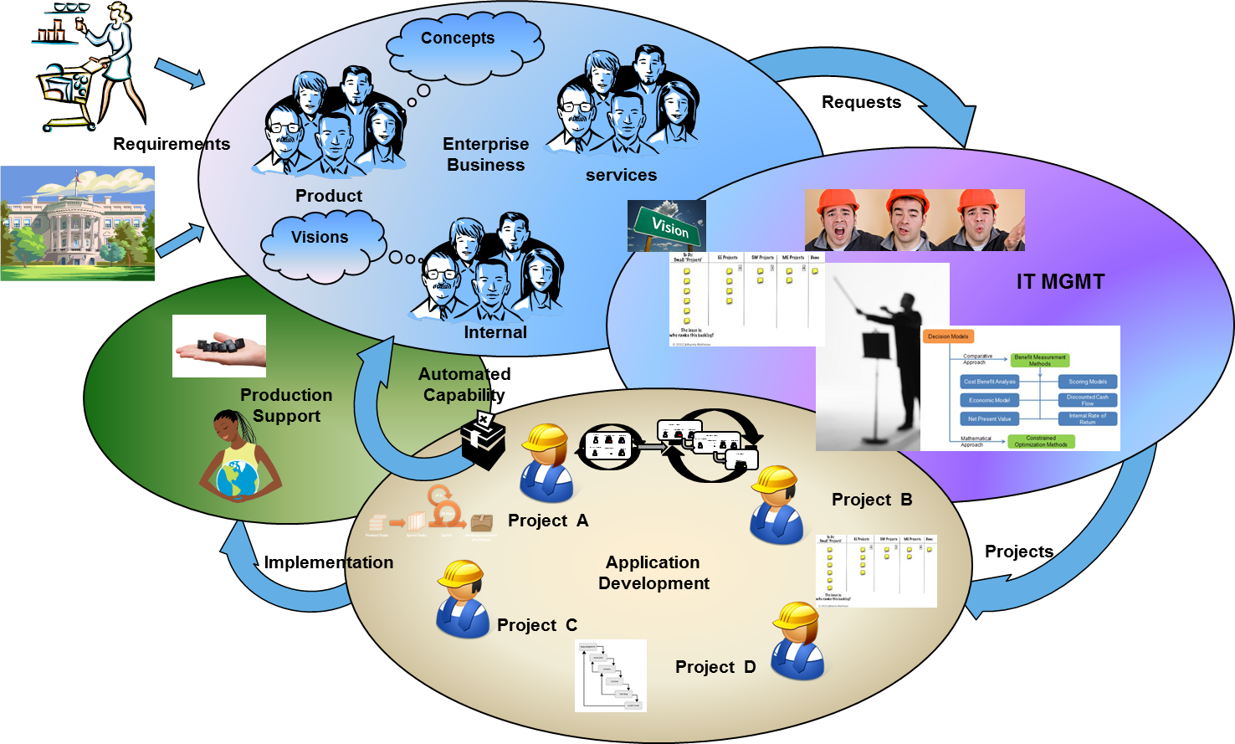
Daikibo Enterprise Value Stream Engine
大
規
模
Enterprise
Portfolio Management
Program
Portfolio Management
Notes:
The full representation of what Daikibo strives to encompass from the Enterprise Value Stream is above. The flow is quite simple in that it visualizes the user needs that enter the Value Stream from customer, regulatory and competitor response needs and expectations.
The Enterprise Business Oval
As external requirements enter the system they are typically focused into three key enterprise business component areas, defined in this model as Product, Services and Internal. Most companies encompass products and/or services as being what generates income into the enterprise, their reason for existence. Internal can be defined as those services that keep the lights on in the business, so that products and services for our end customer can be created, delivered and supported.
The IT Management Oval
Once the Enterprise Business team completes the initiation phase of the Value Stream, which entails completing, at a minimum, the definition of vision, objectives and goals, coupled with some level of initial funding to move the “request” into IT management oval. It should have a priority and ranking within the existing lists of requests from a business value view.
The IT Management team would then complete the process to “Stage” the request on the Kanban planning board. The request would then move into Work in Progress (WIP) once one of two things occurs. Capacity opens ad becomes available, usually indicated through the availability of a base project team or we have decided to increase capacity and have the core team available to put the project into play.
Once the project has moved into WIP, it then can be initiated, i.e. fully staff and begin the base planning process work of basic Epic definition for the backlog. The initial roadmap and release plans are created with little thought of velocity at this level. The release plan is based on release visions and objectives, in business language.
The request then becomes a project/program of projects that is monitored and tracked form this enterprise view.
The Application Development Oval
Once projects are selected and funded from the portfolio they will then enter the Application Development Oval. This is where programs and projects are actually completed. The intent is that this area of the framework can and will support most any type of software development management process or method. We will get into how we can manage programs that use multiple approaches in later chapters, but for now understand this is where traditional program and project management re-enters as a critical component and service to the delivery teams.
The Production Support Oval
As external requirements enter the system they are typically focused into three key enterprise business component areas, defined in this model as Product, Services and Internal. Most companies encompass products and/or services as being what generates income into the enterprise, their reason for existence. Internal can be defined as those services that keep the lights on in the business, so that products and services for our end customer can be created, delivered and supported.

Slide 10
The Daikibo Pipeline
Iteration 0
Iteration 1
Iteration 2
Iteration 3
Iteration 4
Iteration N
大
規
模
Team
Concept | First set of stories | Second set of stories | Third set of stories | Fourth set of stories | Fifth set of stories | N+1 set of stories
Delivery (dev+testing) | Prep | First set of stories | Second set of stories | Third set of stories | Fourth set of stories | N set of stories
Validation | Prep | Prep | First set of stories | Second set of stories | Third set of stories | N-1 set of stories
COLLABORATION
DEMO
DEMO
DEMO
DEMO
DEMO
Pipeline Approach
The concept teams produce stories in the leading Iteration. Near the end of the leading Iteration, the delivery teams evaluate the stories and provide effort estimates in points. The concept teams use the effort estimates to tweak the priorities of the stories.
The delivery teams have a Iteration planning session on the first day of the new Iteration. They review the prioritized stories and commit to completing a number of them. The concept team starts to produce the next set of stories.
After the stories have been tested and accepted by the story owners, the new functionality is demonstrated. In the following Iteration, the system integration testing group performs more tests and validates the integration with other systems.

Slide 11
Daikibo – The Teams

Slide 12
Daikibo - The Teams
大
規
模
Core Teams
Meta Team
Concept Team
Delivery Team
Integrated Validation Team
Optional/Other
Business Alignment Team
Business Working Group
Executive Steering Committee/Change Committee
Architectural Directional Team

Slide 13
Daikibo Meta to Concept Interaction
Meta Team
大
規
模
Core Team
Chief
Product owner
Meta Team Lead
Test Lead
Tech Lead
Program Manager
Chief
Architect
SMEs &
SDAs
Product owner
Product owner
Lead Story Author
Lead Story Author
Product owner
Concept Team
Concept Team
Product owner
SMEs & SDAs
Story Authors
SMEs & SDAs
Story Authors
Lead Story Author
Lead Story Author
Test & Technical Ambassador
Test & Technical Ambassador

Slide 14
Daikibo Concept to Delivery Interaction
Concept Team
大
規
模
Product owner
Lead Story Author
Program Manager
SMEs & SDAs
Story Authors
Concept Story Authors
PO Proxy
PO Proxy
Test
Ambassador
Tech Ambassador
Test
Ambassador
Tech Ambassador
Test
Ambassador
Tech Ambassador
Delivery Team
Delivery Team
Test
Ambassador
Tech Ambassador
Developers
Developers
PO Proxy
PO Proxy
ATF
Testers
ATF
Testers

Slide 15
Daikibo Software Development
“Orthodox” Agile-Scrum Approach
One self-organizing, cross-functional team writing stories, designing, developing, testing, and producing production quality functionality in each Iteration. Developers play many roles, including story author and tester.
大
規
模
Concept team
Product owner
Story Authors
Product owner
Delivery team
scrum master
developers
testers
scrum master
Team
Validation Team
automation engineers & testers
“Hybrid” Daikibo Agile Approach
Separate cross-functional teams and bifurcated responsibilities (a producer-consumer model) operating in an incremental-iterative pipeline approach, following Agile principles.
Concept team – story production/generation
Delivery team – story consumption
Validation team – story validation

Slide 16
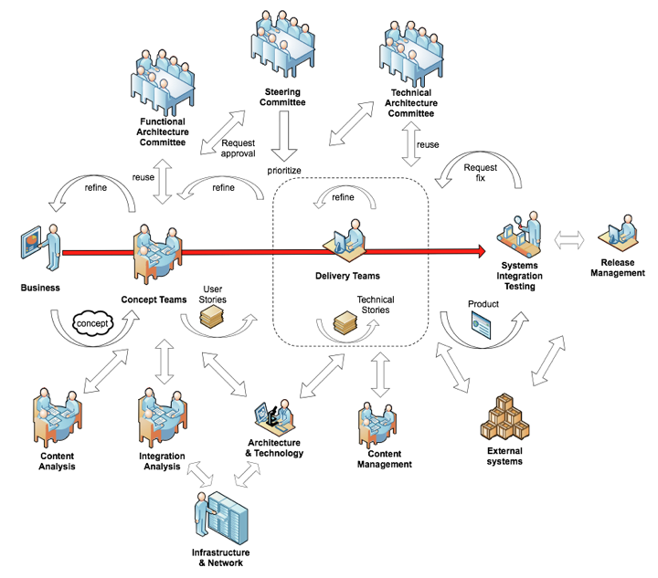
Interaction Model Overview
Process Governance Committee
Focus on the Critical Path
The red line represents the critical path and the flow of information for the project, vis-à-vis pigs and chickens.
Governing Committees – (at the top) provide oversight over the scope, the functional and technical aspects of the project, and the Agile/Scrum process.
Supporting Groups – (at the bottom) identify existing content and manage the loading of copy into the new site; manage the integration with backend and 3rd party systems, oversee the architecture of the site, and plan and build the infrastructure to support the project

Slide 17
Daikibo – The Roles

Slide 18
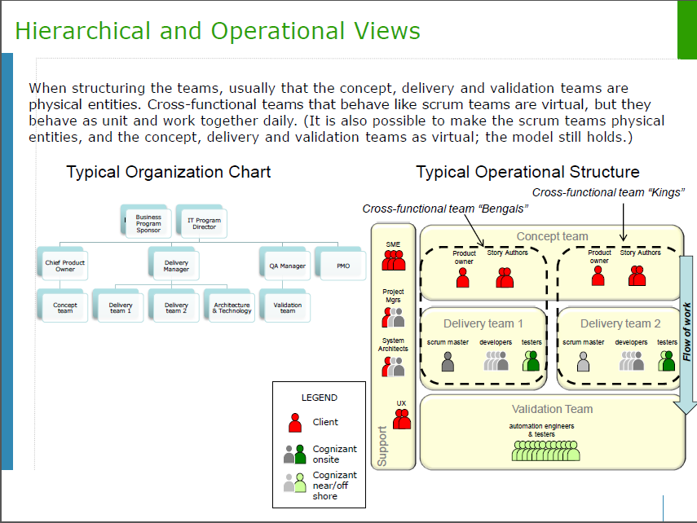

Slide 19
Chief Business Product Owner
The Chief Business Product Owner is a person who is typically the single point of accountability for the success or failure of the complete project from the business point of view.
The Chief Business Product Owner leads a team of Business Product Owners working on pieces of the global Product Backlog. If there are multiple products, the Chief Business Product Owner has to manage a portfolio of backlog items and prioritize across products for each iteration and/or each release.
Key Responsibilities
Providing Vision
Has a clear and compelling vision for the product “Voice of the Customer”
Communicates the vision via prioritized Epics/features in the product /release backlog
Providing Boundaries & Constraints
Examples:
Setting a timetable for delivery
Determining the detailed scope
Setting performance criteria
Set release goals
Key Attributes
Available
Business-savvy
Communicative
Decisive
Empowered
Deming notes that quality decreases after a certain critical mass of inspectors is met: they defer to each others' judgment instead of feeling responsible. Sometimes, one head is better than two.

Slide 20
Business Product Owner
In our definition of the Business Product Owner the role consists of a person who not only understands the business area that is being implemented for a product, but also is the person who “owns” or is fully responsible for the business function of the future area of the product. This is a very challenging role.
Key Responsibilities
Providing Vision
Has a clear and compelling vision for the product “Voice of the Business Product Owner”
Communicates the vision via prioritized user stories in the product /release backlog
Providing Boundaries & Constraints
Examples:
Determining the detailed scope
Setting performance criteria
Approving look and feel
Set Iteration goals
Key Attributes
Available
Business-savvy
Communicative
Decisive
Empowered

Slide 21
Business Product Owner
Detailed Responsibilities as Chief Business Product Owner Proxy
Is the "go to" person for domain information | Is an active participant in modeling
Provides timely information and decisions | Is an active participant in customer testing
Prioritizes requirements, defects, and other work items for the team | Helps the team gain access to expert Business support when needed
Facilitates requirements modeling sessions, including requirements envisioning (the Agile Coach will help in this) | it is the BPO’s responsibility to consider which activities will produce the most business value
Educates team in the business domain | Is the gateway to funding

Slide 22
Meta Team Project Manager
Meta team Project Manager works with the Business Product Owner and Meta Team Lead to ensure the success of the Program. Works with Concept Team Project Managers and supports the program by facilitating Issues/Blocks/Risks reviews, monitoring critical path and providing status reports
Key Responsibilities
Support Program Road-map
Supports Program Critical Path
Works closely with Concept Team Project Managers
Monitors Risk Log for the team
Monitors Issue Log for the team
Facilitates reviews of Issues/Blocks/Risks
Escalates Issues/Blocks/Risks as required
Gathers and provides status reports on progress
Publishes and reports team agile metrics
Key Attributes
Responsible
Mentor
Collaborative
Committed
Influential
Knowledgeable
Respected
Organizer
PgM Skills
Leader
This role is to provide Project Management support to the program in terms of risks, issues, reports and budgets, does not have any command and control over others

Slide 23
Concept Team Project Manager
Concept Project Manager works with the Business Product Owner & Team Lead to help ensure the success of the Project. Works closely with the ATF’s and Project Managers. Monitors Concept Team level critical path, Issues, Blocks, and Risks. Facilitates reviews and escalation and provides status reports.
Key Responsibilities
Works closely with ATFs
Supports Concept team level Critical Path
Monitors Risk Log for the team
Monitors Issue Log for the team
Facilitates reviews of Issues/Blocks and Risks within the project
Escalates issues/Blocks and Risks outside the Concept team to meta team
Provides status reports on project/team progress
Publishes and reports team agile metrics
Key Attributes
Responsible
Collaborative
Committed
Dedicated
Knowledgeable
Respected
Organizer
PM Skills
This role is very different from the classical project manager role no command and control over team, always in the support role, dedicated to one or more teams

Slide 24
Agile Team Facilitator/Scrum Master
Our definition of the Agile Team Facilitator (ATF) the role consists of a person who is a facilitator not a director.
The ATF is not the team leader, but acts as a buffer between the team and any distracting influences. The ATF ensures that the Defined Agile process is used as intended. The ATF is the enforcer of rules.
Key Responsibilities
A servant-leader, leading by example
A catalyst
An influencer not a decision maker
Authority is limited to ensuring their team follows the Agile process
Daikibo/Agile Champion
Guide their team in following the Agile process
Facilitation, not direction
Key Attributes
Responsible
Humble
Collaborative
Committed
Influential
Knowledgeable
A “people person”
Respected

Slide 25
Story Author (BA)
The story author in the Meta Team works with the Chief Business Product Owner to author Epics and Features. The story Author in the Concept Team works with the Business Product Owner to author user stories
Key Responsibilities
Responsible for authoring Epics, features and user stories
Ensures that the acceptance criteria is complete in all respects
Helps Chief Business Product Owner to manage the product backlog
Helps Business Product Owner to elaborate user stories with the delivery and Integrated validation teams
Sometimes plays the role of Business Product Owner Proxy
Helps in creating supporting documents for user stories
Key Attributes
Available
Business-savvy
Communicative
Decisive
Empowered
Story Authors need many of the business analysis skills of the BA

Slide 26
Business Product Owner Proxy
Business Product Owner Proxy plays the role of Business Product Owner to the delivery team. You can think of this role as an ambassador from the business to the delivery team. This role is usually created when the Business Product Owner has many other responsibilities and also when the delivery team is in a different location this role supports the delivery team as Business Product Owner in their time zone
Key Responsibilities
Elaborates user stories to the delivery team
Elaborates on the functionality and acceptance criteria to the delivery team
Answers questions from the delivery team during the iteration
Empowered to accept stories during the iteration
Can be a story author from the concept team
Helps in creating supporting documents for user stories
Key Attributes
Available
Business-savvy
Communicative
Decisive
Empowered
Business Product Owner proxies need many of Skills possessed by the Story Authors

Slide 27
Agile Program Manager
Program Manager works with the Chief Business Product Owner and Program Leadership to ensure the success of the Program. Works with Meta and Concept team leads & Project Managers to support the program by identifying and mitigating risks, resolving issues & Dependencies across projects both internally and externally.
Key Responsibilities
Supports Program Road-Map
Support Critical Path
Support Release Plan
Guide and mentor Concept & Meta Team leads
Resolve issues/blocks outside the Meta team purview
Manage Program Financials to budget
Vendor Management
Resource Management
Key Attributes
Responsible
Mentor
Collaborative
Committed
Influential
Knowledgeable
Respected
Organizer
Leader
This role provides management support to the program in terms of risks, issues, reports and budgets

Slide 28
Meta Team Lead
Meta Team Lead works with the Chief Business Product Owner and Program Manager to ensure the success of the Program. Collaborates with Concept Team Leads to support the program by identifying critical path, mitigating risks, resolving technical challenges/dependencies within, across concept teams and outside the program. Works closely and in tandem with the Agile Coach.
Key Responsibilities
Owns Program Critical Path
Support Chief Business Product Owner in prioritization
Support release planning
Identify engineering dependencies within & externally across program(s)
Identify Architecture Risks
Guide concept team leads from program content
Resolve issues/Blocks outside the Meta/Concept team purview
Resource Management (may push to PM)
Daikibo & Agile Champion
Key Attributes
Responsible
Mentor
Collaborative
Committed
Influential
Knowledgeable
Respected
Organizer
Champion
This role helps Chief Business Product Owner to identify critical path, engineering dependencies and architecture risks

Slide 29
Concept Team Lead
Concept Team Lead works with the Business Product Owner and Meta Team Lead to ensure the success of the Program. Supports the program by identifying & managing critical path across teams for the concept area, identifies engineering dependencies across teams
Key Responsibilities
Owns Critical Path within Concept team
Support Business Product Owner in prioritization
Identify engineering dependencies within Concept team
Identify Architecture Risks for Concept team
Escalate technical issues and risks to meta team lead
Resolve technical issues blocks within Concept and delivery teams under concept team
Resource Management
Works with ATFs
Daikibo & Agile Champion
Key Attributes
Responsible
Mentor
Collaborative
Committed
Influential
Knowledgeable
Respected
Organizer
Leader
This role helps Business Product Owner to identify critical path, engineering dependencies and architecture risks

Slide 30
Key Role Responsibility Matrix
Role | Client | Cognizant
Steering Committee | X | X
Agile CoE (if the client has one) | X | X
Chief Architect | X | X
Chief Product Owner | X
Feature Area Product Owner | X
User Experience Expert/Guide | X
Story Authors (a.k.a. Business Analysts) | X | X
Product Owner Proxies (if necessary) |  | X
Agile Coach |  | X
Scrum Masters |  | X
Developers |  | X
Testers | X | X
Support Teams | X | X
Program Management | X | X

Slide 31
Daikibo – The Agile Coach

Slide 32
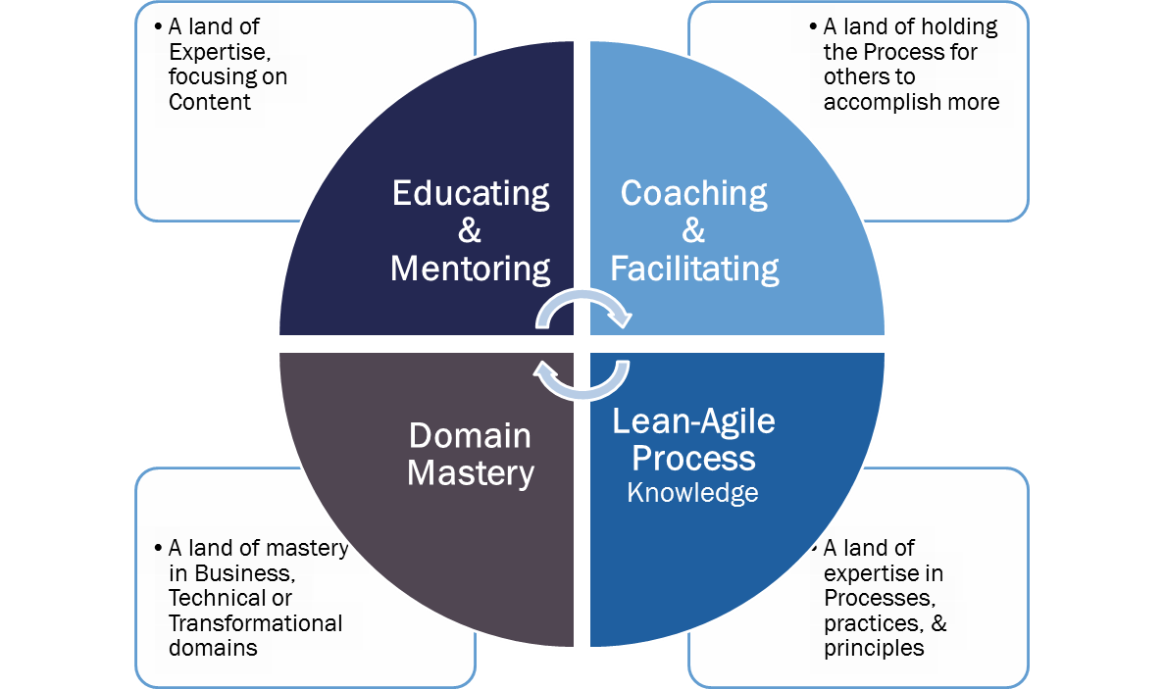
The Agile Coach
Referencing the coaching competency model from the Agile Coaching Institute:
Coaching & Facilitating
The ability to guide in the context of the client direction
Educating & Mentoring
The ability to impart knowledge and experience to help one or many grow in understanding
Domain Mastery
Composed of business, technical, and transformational mastery
Lean-Agile Process Knowledge
Knowing, applying and practicing Agile in support of the values and principles
http://www.agilecoachinginstitute.com/

Slide 33
Daikibo – The Iteration

Slide 34
Iteration Activities
LEGEND
Entire Team
Story Authors & Product Owners
Developers
Testers
Example 2-Week Iteration (10 days)
Sun | Mon | Tues | Wed | Thurs | Fri | Sat
 |  |  | 1 | 2 | 3
 | 4 | 5 | 6 | 7 | 8
 | 9 | 10
Stories Finalized¹
Prioritize Backlog¹
Estimate¹
Iteration Planning¹
Commit to Iteraiton¹
Daily scrum
Identify, draft, and socialize stories for Iteration n+x
Design & Development
Build and execute test cases
Design & Development
Identify, draft, and socialize stories for Iteration n+x
Build and execute test cases
Daily scrum & Acceptance
Development & Testing completes
Daily scrum
Iteration Review Retrospective
Stories Finalized¹
Prioritize Backlog¹
Estimate Stories for Iteration n+1
Iteration N+1: Assumes stories are at the right level and ready to be discussed; while everyone attends estimation meetings, only developers & testers provide estimates
Iteration N+X: Assumes the stories are for any future Iteration

Slide 35
Daikibo - Release Planning

Slide 36

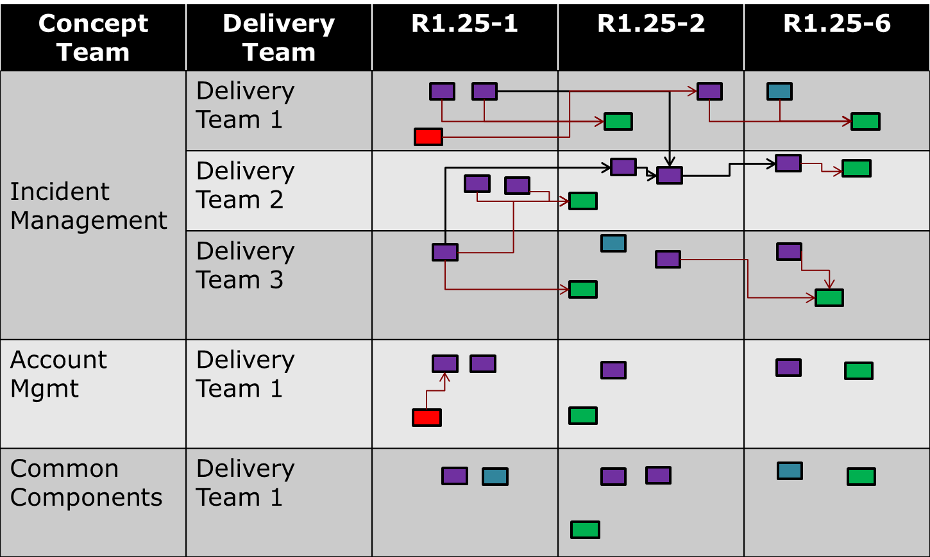
Release Planning
Effective release planning accentuates negotiation and delivery of core-critical path items to reach minimum marketable readiness as quickly as possible.
Backlog to Plan
Release Planning is a continual activity within a regular known cadence for large scale Agile processes that moves the vision from the product backlog to a 6 iteration plan for all delivery teams across a program.
Release plans act as a planning and communication tool to combat over-optimism.
Notes:
The key points for release planning are as follows:
The main driver for your sub-release schedule is the length of your development iterations. We on the Horizon project have decided on 2 week iterations, so the sub-release will be 12 weeks or 6 iterations in length
The iterations them selves have the detailed planning and it is the first point hard commitment is made by the actual deliverers of the functionality. Release planning is just that, a best guess plan based on known velocity.
Most projects are constrained by a target-completion date. You can create your release plan by working backward from this target date. Typically the target date represents the “Market Ready Release” or full release. In large Scale we plan in sub-releases of 6 iterations.
Stories are assigned to iterations based on priorities and estimated size and dependency. The concept teams who define the product vision through user stories for the delivery teams and IVT team to consume and deliver to.
In larger organizations, you need to communicate the release plan to stakeholders and support groups.
Also the Meta and Concept teams will plan their coming sub-release plan as well. This plan is centered on features to be groomed for the next sub-release

Slide 37
Release Planning Lag – calendar?
Sunday | Monday | Tuesday | Wednesday | Thursday | Friday | Saturday
 | Day -3 | Day -2 | Day -1 | Day 1 | Day 2
 | Meta Team identifies key items for Release Lag backlog | Concept teams Refine backlog for release lag | Meta and concept team review release lag backlog and refine | Delivery and IV teams Iteration Planning Prepare for Release Planning | Delivery and IV teams work on release lag backlog Final Preparations | Travel day for Release Planning
 | Day 3 | Day 4 | Day 5 | Day 6 | Day 7
Travel day for Release Planning | Delivery and IV teams work on release lag backlog | Release Planning Day 1 Plan for Delivery and IV Teams | Release Planning Day 2 Plan for Delivery and IV Teams | Release Planning Day 3 Plan for Meta and Concept Teams | Delivery and IV teams work on release lag backlog
 | Day 8 | Day 9 | Day 10
 | Delivery and IV teams work on release lag backlog | Share Subsequent release with DT and IVT | Release Demo & Retro Subsequent release review with stakeholders

Slide 38
Release Planning Wall
Concept Team | Delivery Team | R1.1-1 | R1.1-2 | R1.1-6
Incident Management | Delivery Team One
 | Delivery Team Two
 | Delivery Team Three
Enrollment | Delivery Team One
Common Components | Delivery Team One
User Story
Technical Story
Spike Story
QA Story
Dependency
Notes:
As teams do their planning they will place stories into iterations for each delivery team.
Teams will use strings of yarn to indicate dependencies between stories.
We will use colored circle stickers on the cards to indicate the different kinds of stories (technical, QA, defect, etc.)

Slide 39
Daikibo – Key Artifacts & Metrics

Slide 40

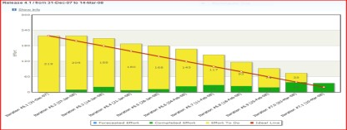
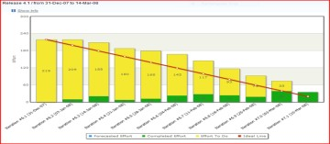
Key Agile Artifacts
Product & Release Backlogs
Impediment or issues list
Vision
Product/ Program Burndown
Roadmap and Release Plan
Program Reports and supporting documents
Iteration Backlog
Iteration/ Release Burndown
QA Metrics
39

Slide 41
Artifacts of Daikibo
# | Document | Ideal Tool | Viable Alternate Tool | Owner
1 | Definition of Done | Wiki | Word/Sharepoint | Scrum Master
2 | Epic Story | BIC¹ ALM | Word/Sharepoint | Product Owner
3 | User Story | BIC ALM | Word/Sharepoint | Story Author
4 | Screens: Sketch, Low-fidelity, High-fidelity | BIC Drawing tool | PPT/Sharepoint | User Experience
4 | Technical Story | BIC ALM | Word/Sharepoint | Developer/Architect
5 | Tech Design Doc | Wiki | Word/Sharepoint | Developer
6 | Code | Source Code Control | Source Code Control | Developer
7 | Observations List | HP-ALM | Excel/Sharepoint | In-Scrum Tester
8 | Traceability Story-to-Test Case | BIC ALM=HP-ALM | Excel/Sharepoint | In-Scrum Tester
9 | Test Plan (per Iteration) | HP-ALM | Word/Sharepoint | In-Scrum Tester
10 | Test Case | HP-ALM | Word/Sharepoint | In-Scrum Tester
11 | Test Scenario | HP-ALM | Word/Sharepoint | In-Scrum Tester
12 | Automation Test Scripts | QTP | Source Code Control | Validation Tester
13 | Daily Report | BIC ALM | Excel/Sharepoint | Scrum Master
14 | Release Plan | BIC ALM | Excel/Sharepoint | Product Owner
15 | Solution Architecture | Wiki | Word/Sharepoint | Architect
16 | Retrospective Action Items | Wiki | Word/Sharepoint | Scrum Master
17 | Issues & Risks Log | Wiki | Excel/Sharepoint | Project Manager
18 | Communication Plan | Wiki | Word/Sharepoint | Project Manager
¹ Best-In-Class

Slide 42
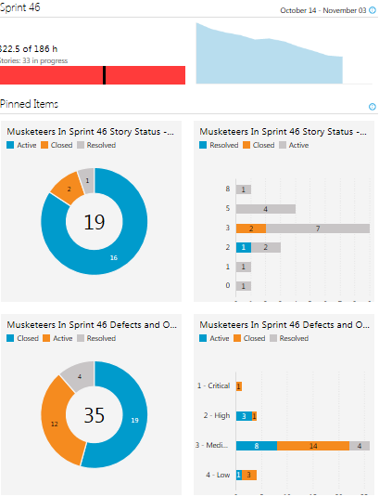
Team Iteration Dashboard

Slide 43
Daikibo – Best Practices

Slide 44
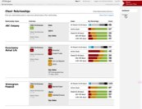
Business Engagement
Product Owners are supported by peers, stakeholders, or end-users in the form of a Business Working Group.
The Business Working Group supports and works with the Product Owner to improve the user stories, provide honest feedback on the demo, and help drive product adoption.
Their time commitment is typically less than 8 hours per month.
Sep 2010 | Oct 2010 | Nov 2010 | Dec 2010 | Jan 2011
Feature Set
UAT
0
1
Demo
2
Demo
3
Demo
4
Demo
5
Demo
Release 1
2 Weeks
2 Weeks
Iteration 1
Iteration 2
4
Product Backlog
User Story 1
User Story 2
User Story 3
Product Backlog
User Story 1
User Story 2
User Story 3
User Story 4
User Story 5
Feedback on features presented are documented in new user stories.
Concept Team
Product Owner(s)
Story Authors
3
Concept and Delivery teams demonstrate working software to Business Working Group.
1
Concept team has daily meetings with business and SMRs to add to the product backlog.
Delivery Team
Developers
Testers
Iteration Backlog
User Story 2
User Story 3
User Story 6
Working Software
2
Business Working Group reviews and improves the new user stories prior to development.

Slide 45


Daikibo – Governance
大規模
Global Integrated Teams | Global Distributed Teams
Onsite
Distributed
Onsite
Distributed
Steering Committee
Steering Committee
Chief Product Owner
Client
Exec
Sponsor
CTS
Exec
Sponsor
CTS
Experts
Chief Product Owner
Client
Exec
Sponsor
CTS
Exec
Sponsor
CTS
Experts
Operating Committee
Operating Committee
Product Owners
Client
PgM
CTS
PgM
CTS
Architect
Agile Coach
Delivery
Manager
Solution
Architect
Agile Champion
Product Owners
Client
PgM
CTS
PgM
CTS
Architect
Agile Coach
Delivery
MGR
Solution
Architect
Agile Champion
Concept Team
Concept Team
Delivery Teams
Product Owner
SMEs
Tech
Experts
Product Owner Proxies
Product Owner
SMEs
Tech
Experts
Product Owner Proxies
Product Owner
Proxies
Scrum Masters
Developers
Testers
Delivery Teams
Validation Team
Developers
Product Owner
Proxies
Scrum Masters
Developers
Testers
Product Owner
Proxies
Scrum Masters
Testers
Validation Team
Testers
QA Lead
Testers
44

Slide 46
Backlog Parent Child Relationships
Theme
Parent Feature
Epic
Feature
Feature
Feature
Portfolio
Implementation
Story
Story
Parent Story
Parent Story
Parent Story
Story
Story
Story
Story
Story
Story
Task
Task
Task

Slide 47
Stories – Types
Types of Stories | Short Example
User Story | As a dealer I would like to update my customer's address in the customer information system so that I am able to contact him when the vehicle is ready
Technical Story | As the developer, I need customer data interface to the billing system to be able to change the dealers customers address. Technical work activities also belong on the agile backlog. An example of technical work would be, "Upgrade all developers' workstations to Windows 7."
QA Story | As a billing assistant I want the customer's address to be updated immediately in the billing system when the dealer changes the address in the customer information system so that I can send the bill to the correct address
Spike | Spikes are a type of story that are used for activities such as research, design, exploration and even prototyping. The purpose of a spike is to gain the knowledge necessary to reduce the risk of a technical approach, better understand a requirement, or increase the reliability of a story estimate. An example of knowledge acquisition Spike could be a backlog item about researching various JavaScript libraries and making a selection

Slide 48
Estimation
Daikibo utilizes the Three Types of Estimation approach from Cognizant:
Balanced Estimations – A method for estimating the number of Agile teams and the number of Iterations it will take to deliver the given scope.
Story Estimation – Using planning poker and the Fibonacci sequence, each Agile team estimates their ability to deliver the functionality for a given user story
Task Estimation – Agile Team members estimate the number of hours each task will take to accomplish.

Slide 49
Continuous Integration
Maintain code repository
Everyone commits regularly, ideally everyday
Every commit should be built
Watch Code
Build Product
Run Tests
Publish results
Everyone can see results of the latest build
Make it easy to get the latest deliverables
Automate Build
Keep the build fast
Automate deployment
Make the build self-testing
Test in a clone of the production environment
Advantages
Early warning of broken code
Early warning of conflicts, merge issues
Immediate unit testing of all changes
Immediate feedback of the system level impact of the code change
Frequent check in forces developers to create modular, less complex, more maintainable code

Slide 50
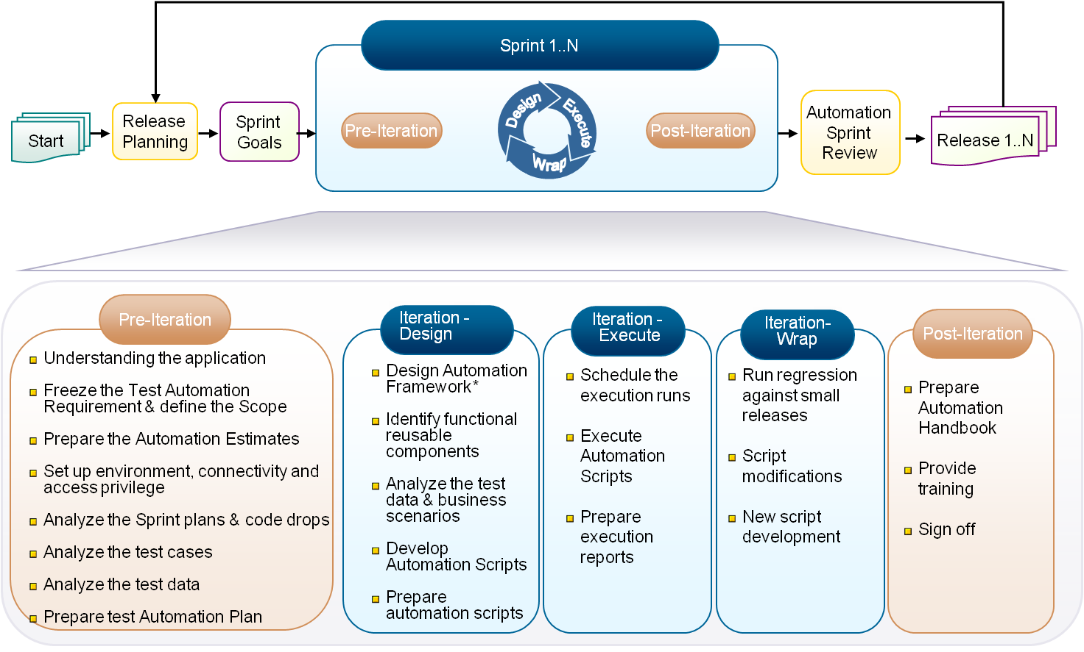
Automated Testing
Automation Methodology supports test automation involving automated test tools and incorporates a multi-stage iterative process to be followed in an Agile environment
This methodology details the regression testing activities that are required to happen on the current Iteration to ensure that the incremental development has not broken the functionalities of the preceding Iterations
It covers test development and test design, and addresses test execution and management of the integrated system developed in an iterative model
The methodology ensures the incremental development of automated regression pack till the nth Iteration

Slide 51
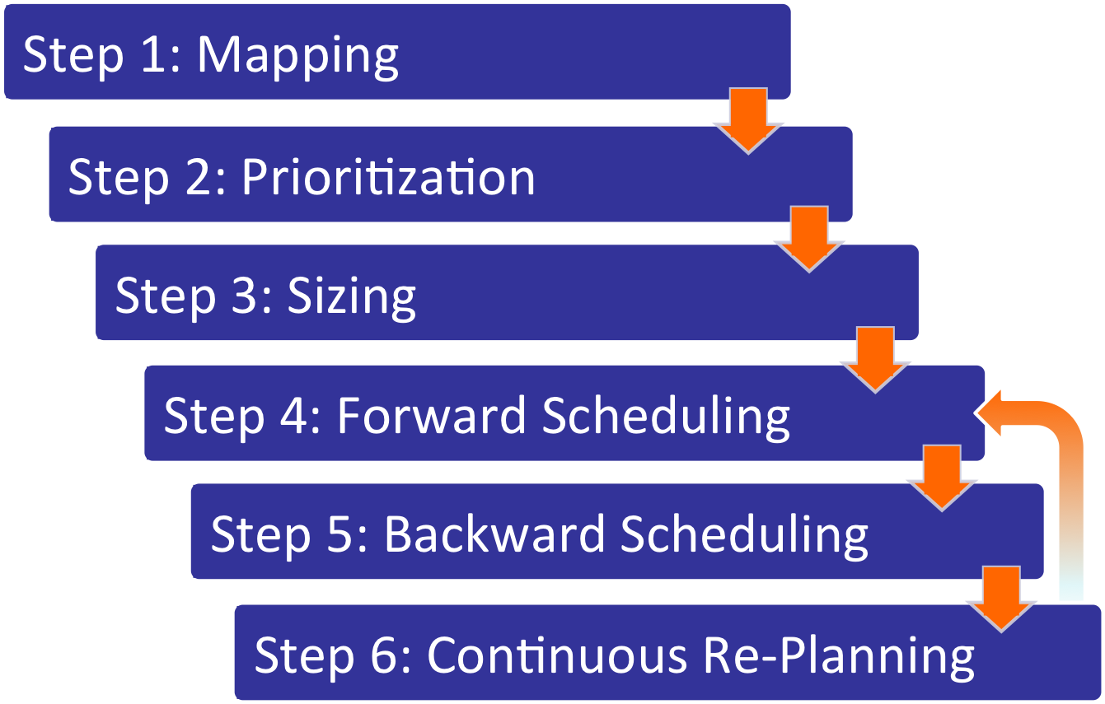
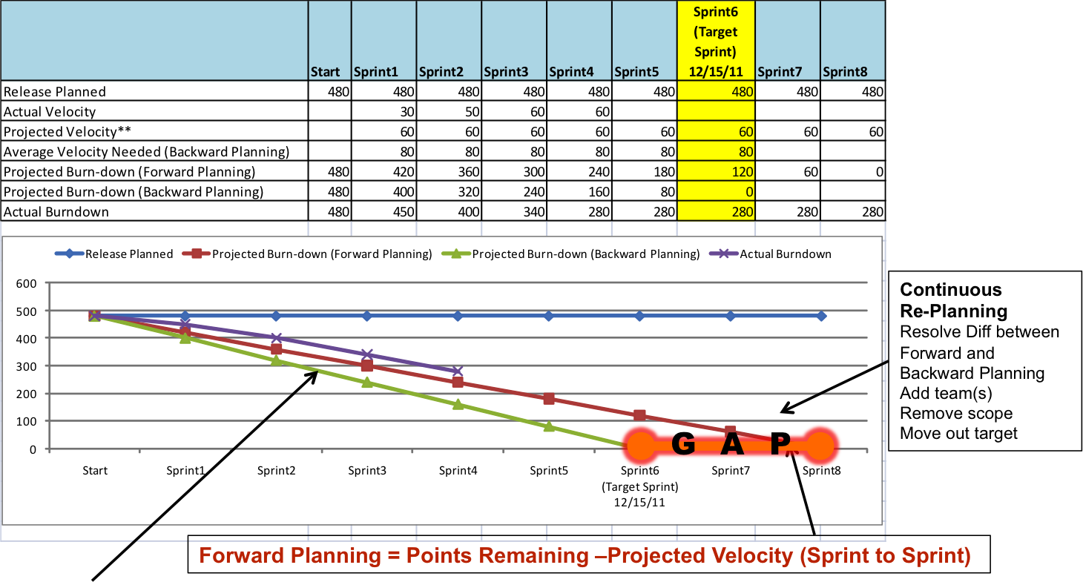
Release Planning
Lessons Learned:
Mind the gap!
Aggressively repeat the process to shrink the gap
Include the entire team in the process, not just the leads
Don’t attempt to complete all six steps in the same day
Perform at least once per quarter

Slide 52
Cognizant Agile Strengths
Plan | Prepare | Build | Deploy
Strategic
Agile CoE Support
Enduring Teams
Cognizant Formula
Capture & publish best practices
Two-In-a-Box Agile Coaches
Assessments
Delivery Model
Training Programs
Funding Model
Release management
Convergent Estimation
Tactical
PO Review & Feedback Cmte
releases
Epic Estimation
Daily Office
Forecasting
Charter
Iteration Zero
Story Creation Process & vertical slicing
KT
Agile Testing

Slide 53
Daikibo - Closing

Slide 54
Differences between Scrum and Daikibo
The day-to-day basis looks similar to Scrum, but there are several differences:
Team structures – concept, delivery, and validation teams are different from scrum teams
The Story Creation Process follows a Kanban-XP model
Product Owner Proxy role – used with integrated teams
Producer-consumer model and the role of metrics in decision support
Three explicit types of estimation: Balanced Estimation(SM), Story Estimation and Task Estimation
Separation of estimation from Iteration Planning
Addition of Forecasting meetings
A primary benefit is that Daikibo has been designed to be scalable and enable distributed/integrated agile teams to be successful.

Slide 55
Distributed or Integrated Scrums?
Must Agile teams work in the same room, face-to-face every day for the project to succeed?
NO!
Can a fully distributed scrum team be just as productive as a scrum team in the same room?
Can large enterprise implementations with fully distributed Scrum teams be just as productive as one with all teams in the same location?
YES!
YES!

Slide 56
Key Learnings
Performing large-scale distributed Agile/Scrum successfully is difficult
Highly structured
More documentation
Follow an opportunistic approach to developing functionality
Release plans instead of project plans
Allow time for a team to learn and internalize its Agile process
Know the 5+5 rule: it takes 5 iterations to learn what to do and 5 iterations to do it better
Understand Shu – Ha - Ri

Slide 57
Key Learnings
Enable the whole team
Every team member is valuable, has a specific role and knows what to do to make the team successful (like a military combat team).
Early iteration results will be uneven; look for trends.
Osmotic communication is hard in the distributed model.
Focusing only on “doing” Agile is a mistake – “being” Agile is equally important.
Focus on managing the critical path, integration, risks and issues.

Slide 58
Daikibo - Appendix

Slide 59
The Inverted Triangle
Waterfall
Agile
fixed
Plan Driven
$$$
Time
Scope
Value Driven
Time
$$$
Scope
flexible

Slide 60
Scrum Teams vs. Daikibo Teams
Scrum Teams
Daikibo Teams
Story Authors
Developers & Testers
QA team
Teams aligned by functional grouping
Scrum team 1
Validation
Scrum team 2
Cross functional Team A
Scrum team 3
Integrated testing
Cross functional Team B
Automated testing
Ideal Scrum team
Generation
Realization
Validation
Performance
testing
Cross functional Team C
Product owner
2 story authors
Scrum master
3 developers
2 functional testers
Concept teams
Delivery teams
Validation team
Flow of work
Flow of work

Slide 61
Terms and Definitions
# | Term |  | Short Definition
1 | Iteration |  | A short timeframe, usually 2-4 weeks, wherein teams collaborate with product owners to develop working and valuable software. Usually performed in a series.
2 | User Story |  | Short, plain language narratives of features, in business terms, from a particular point of view; each includes acceptance criteria.
3 | Product Backlog |  | List of user stories, ordered by business value and the scrum team’s effort estimate.
4 | Product Owner |  | An individual, usually from the business, that provides or represents the voice of the customer. Owner of the product backlog.
5 | Scrum Master |  | An individual that has responsibilities to facilitate the daily scrum meeting, facilitate story point/effort estimation, monitor team progress against their committed goal, guide the team on agile process, and assist the product owner in ordering the product backlog.
6 | Iteration Backlog |  | List of stories that the scrum team is working on in a Iteration.
7 | Daily Standup |  | 15 min daily meeting where scrum team members briefly describe what they accomplished yesterday, plan to accomplish today, and any impediments they encountered or expect to encounter today.
8 | Scrum of Scrums |  | 15 min daily meeting where product owners and scrum masters discuss impediments and cross team dependencies.
9 | Story Points |  | Estimated effort assigned to a user story by developers and testers
10 | Velocity |  | Number of story points that a scrum team can complete in a given Iteration
11 | Burndown chart |  | The primary report, produced daily, that shows the progress of the team against the committed goal for a given Iteration.
12 | Iteration Review |  | On the last day of a Iteration, the entire project attends as the team demonstrates the functionality that was built during the Iteration. Also known as “the demo”.
13 | Retrospective |  | On the last day of a Iteration, each team discusses what worked, what didn’t work, and what they need to do better in the next Iteration.

Slide 62
XP Practices used by Daikibo
Whole Team
Customer Tests
Engineering Practices
Pairing
Test Driven Development
User Stories
XP Practices
Metaphor
Simplicity
Re-factoring
Continuous Integration
Sustainable Pace
Small Releases

Slide 63
Lean Principles Used by Daikibo
The House of Lean
Customer-focused
Best Quality, Lowest Cost, Shortest Lead time by continuously eliminating waste. Most customer delight. High Morale. Safety.
Teams continually seeking a better way
Just-in-time
Baked-in Quality
Foundation: Management Support

Slide 64

Scrum Practices Used by Daikibo
Daily Scrum
adapt & learn
evaluate & select
commit
Iteration backlog
perform
demonstrate
retrospective
Product backlog
timebox
Project begins
Project ends
Iteration
Iteration
Iteration
Iteration
Iteration
Iteration
Iteration
Iteration
Iteration
Iteration

